Slide 1
Elliptic Curves
Number Theory and Cryptography

Slide 2

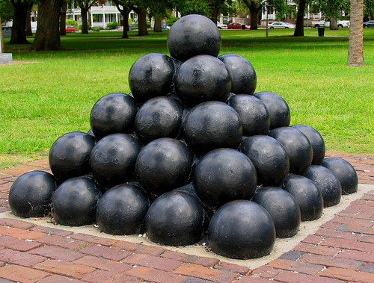
A Pile of Cannonballs A Square of Cannonballs

Slide 3
1
4
9
.
.
.

Slide 4
The number of cannonballs in x layers is
1 + 4 + 9 + . . . + x²
= x (x + 1) (2x + 1)/6
x=3:
1 + 4 + 9 = 3(4)(7)/6 = 14

Slide 5
If x layers of the pyramid
yield a y by y square,
we need
y² = 1 + 4 + 9 + . . . + x²
y² = x (x + 1) (2x + 1)/6

Slide 6
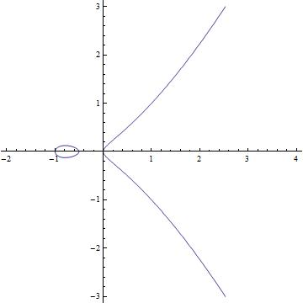
y² = x (x + 1) (2x + 1)/6

Slide 7
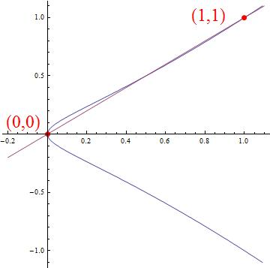

Slide 8
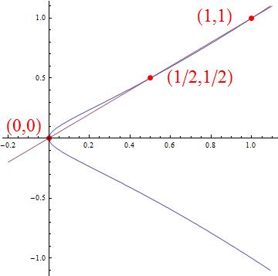
y² = x (x + 1) (2x + 1)/6 and y = x

Slide 9
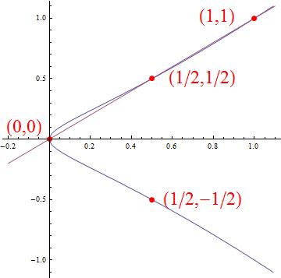

Slide 10
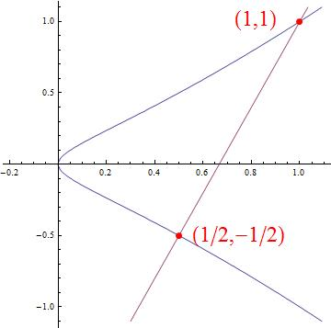

Slide 11
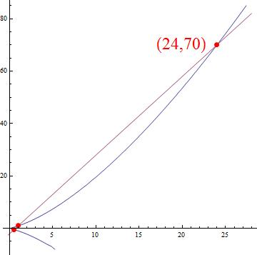

Slide 12

1 + 4 + 9 + . . . + 24² = 70²

Slide 13
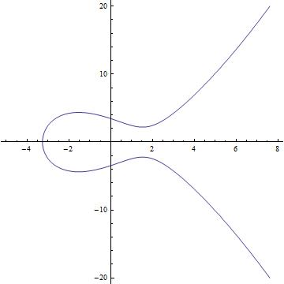
An elliptic curve is the graph of an equation
y² = cubic polynomial in x
For example, y² = x³ – 5x + 12

Slide 14
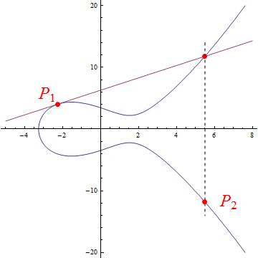
Start with P₁. We get P₂.

Slide 15
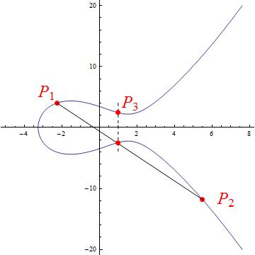
Using P₁ and P₂, we get P₃.

Slide 16
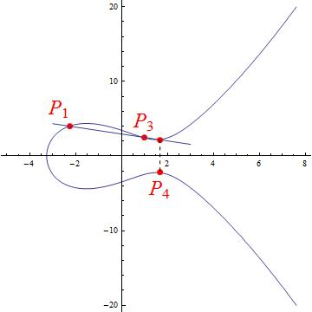
Using P₁ and P₃, we get P₄.

Slide 17
We get points P₁, P₂, P₃, . . . , P_{n} , . . .
All of these calculations are done mod a big prime.
Otherwise, the computer overflows.
Given n , it is easy to compute P_{n}
(even when n is a 1000-digit number)
Given P_{n} , it is very difficult to figure
out the value of n .

Slide 18
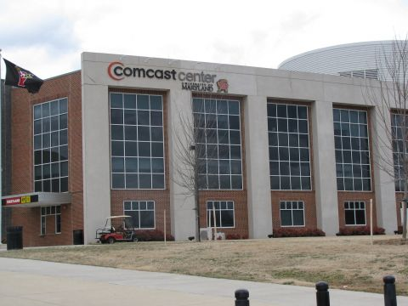





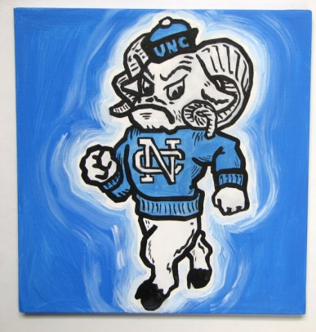



“Do you know the secret?”

Slide 19
The secret is a 200-digit integer s.
Prove to me that you know the secret.
I send you a random point P₁.
You compute P_{S} and send it back to me.

Slide 20

If the Blue Devil knows the secret:

Slide 21
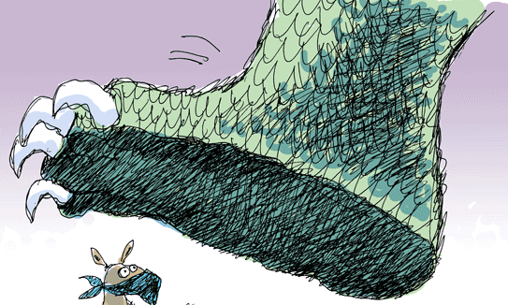


If the Blue Devil doesn’t know the secret:
(apologies to Bambi Meets Godzilla)

Slide 22
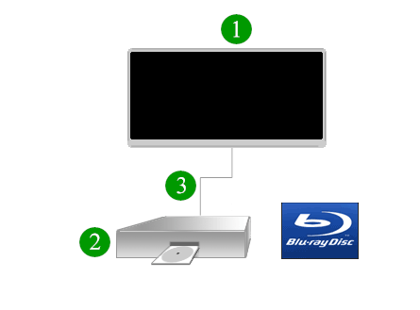

Slide 23


Slide 24
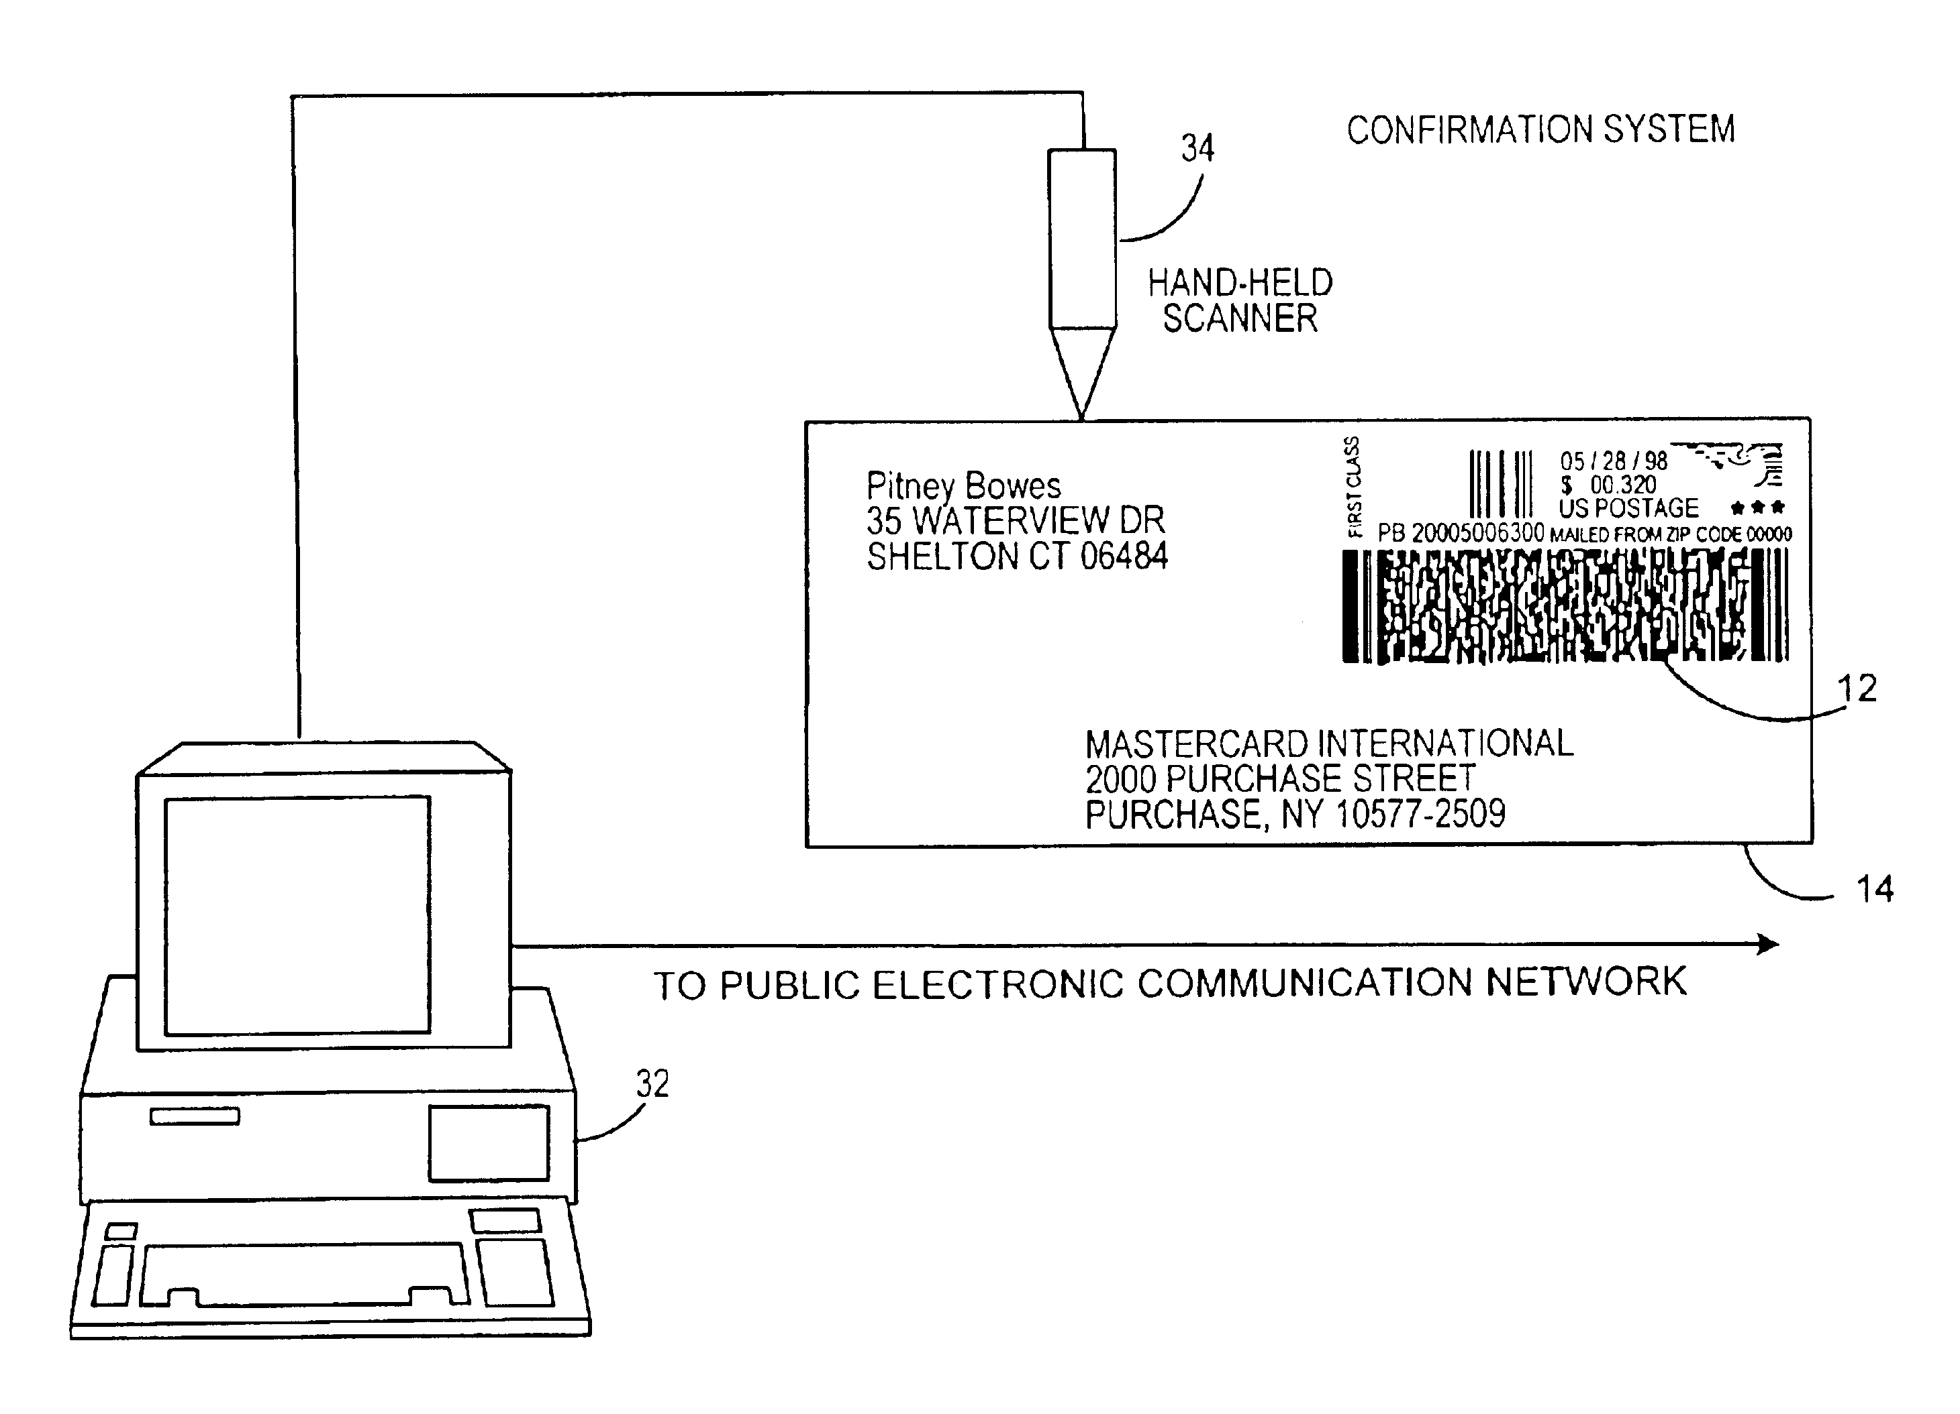

Slide 25


Slide 26
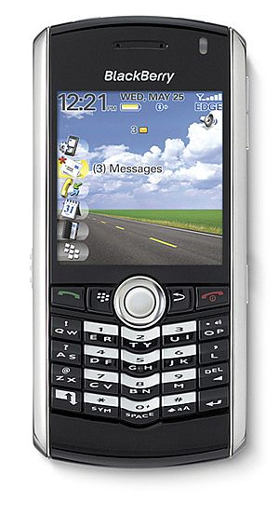
< P , Q >

Slide 27
∞
∞
Define a binary operation “+” on points
of the elliptic curve:
P₁ + P₃ =P₄.

Slide 28
Properties of +:
P + Q = Q + P (commutative)
∞ + P = P + ∞ = P (existence of an element)
P + P’ = ∞ (existence of inverses)
(P+Q) + R = P + (Q + R) (associative law)
The points form an abelian group.

Slide 29
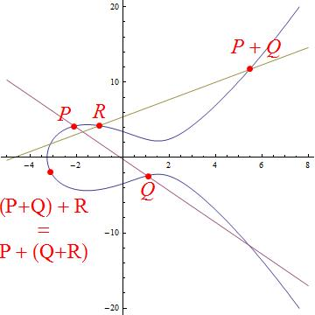

Slide 30
Calculate 1000 P = P + P + P + . . . + P
2 P = P + P
4 P = 2P + 2P
8 P = 4P + 4P
. . .
. . .
1024 P = 512 P + 512 P
1000 P = 512 P + 256 P + 128 P + 64 P + 32 P + 8 P
Even faster: 1000 P = 1024 P – 16 P – 8 P

Slide 31
y² = x³ – 5x + 12 (mod 13)
x x³ – 5x + 12 y
0. 12 5, 8
8 ---
10 6, 7
11 ---
4 2, 11
8 ---
3 4, 9
8 ---
3 4, 9
7 ---
0 0
1 1, 12
3 4, 9
We obtain a
group with
16 elements.
It is cyclic and is
generated by
(2,6)
∞ ∞ ∞

Slide 32
The Discrete Logarithm Problem
Solve 2^{x} = 8192
x = 13
Solve 2^{x} = 927 (mod 1453)
x = 13

Slide 33
The Elliptic Curve Discrete Log Problem
Given points P and Q on an elliptic curve with Q = k P
for some integer k.
Find k
Example: On the elliptic curve
y² = x³ - 5x + 12 (mod 13),
find k such that
k (2,6) = (4,11).
7 (2,6) = (4,11)
The elliptic curve discrete log problem is very hard.

Slide 34
Elliptic Curve Diffie-Hellman Key Establishment
Alice and Bob want to establish a secret encryption key .
Alice and Bob choose an elliptic curve mod a large prime.
They choose a random point P on the curve.
Alice chooses a secret integer a and computes aP.
Bob chooses a secret integer b and computes bP.
Alice sends aP to Bob and Bob sends bP to Alice.
Alice computes a(bP) and Bob computes b(aP) .
They use some agreed-upon method to produce a key from abP.
The eavesdropper sees only P, aP, bP.
It is hard to deduce abP from this information
without computing discrete logs.

Slide 35
Alice and Bob agree on y² = x³ – 5x +12 (mod 13)
and take P = (2,6).
Alice
Bob
a = 7
7 (2,6) = (4, 11)
b = 5
5 (2,6) = (12, 4)
(4, 11)
(12, 4)
7(12, 4) = (8,9)
5(4,11) = (8,9)

Slide 36
THANK YOU

