Slide 1
Long Duration Aeroacoustic Simulation
AMSC/CMSC-664 – Final Presentation
Dilhara Jayasundara
Advisor: Prof. James Baeder
Department of Aerospace Engineering

Slide 2
Outline
Background
Project Description
Goals
ACUM-3
Non-periodic motion module for CFD
ACUM-3
Parallelization
Using GPUs – CUDA
Using CPUs – MPI
Computational time optimization
Modifications to CFD
CFD data output optimization
Development of non-periodic motion module
Validation
Results
Future Work

Slide 3
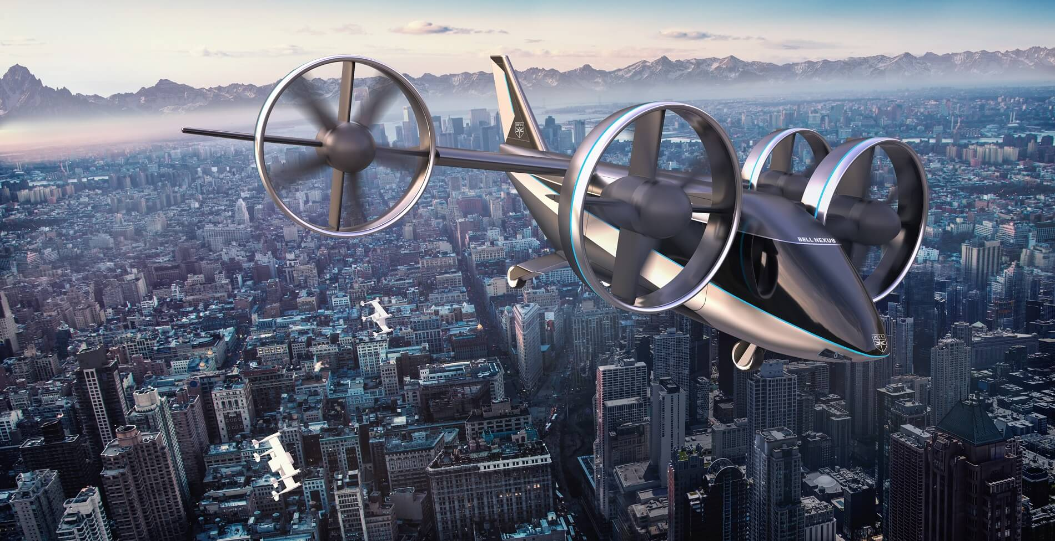
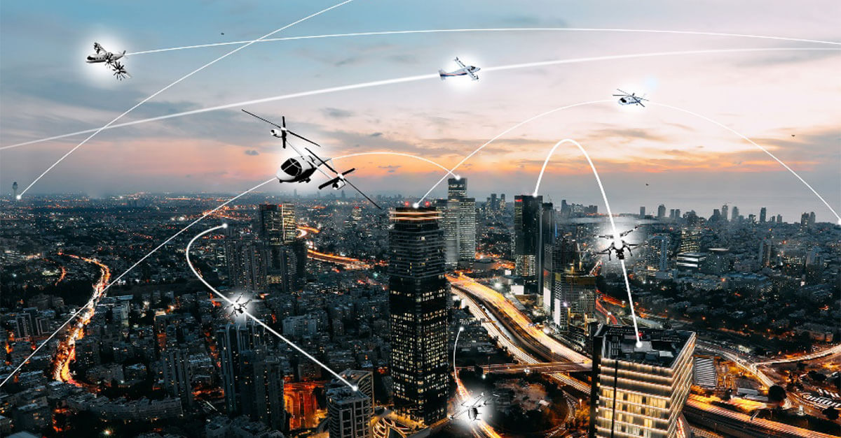
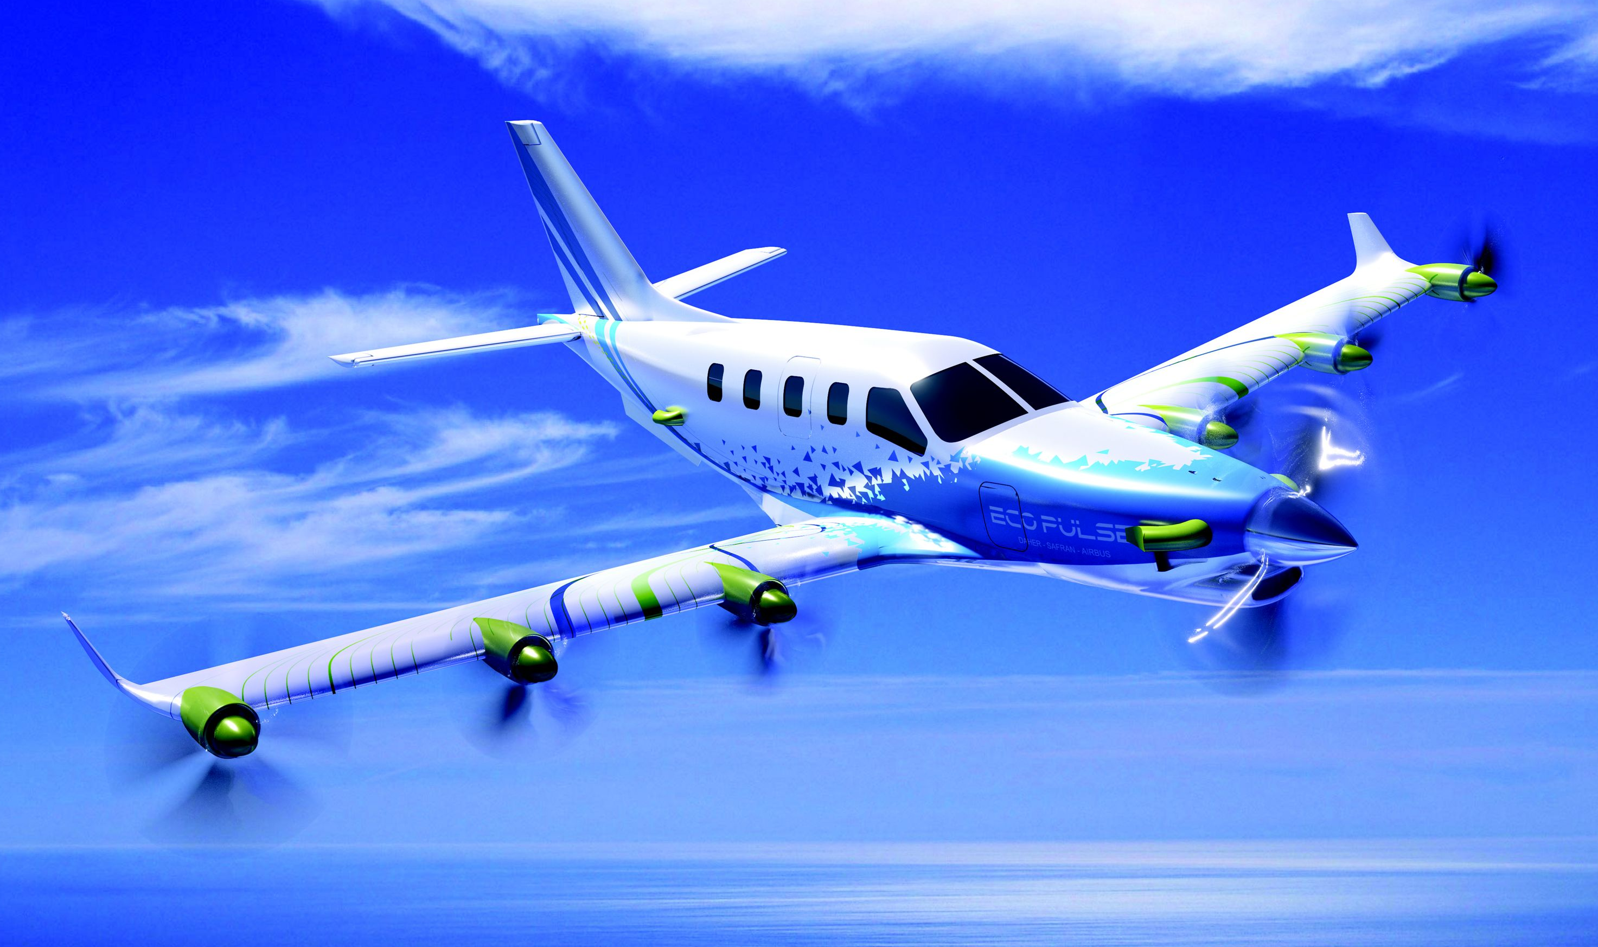
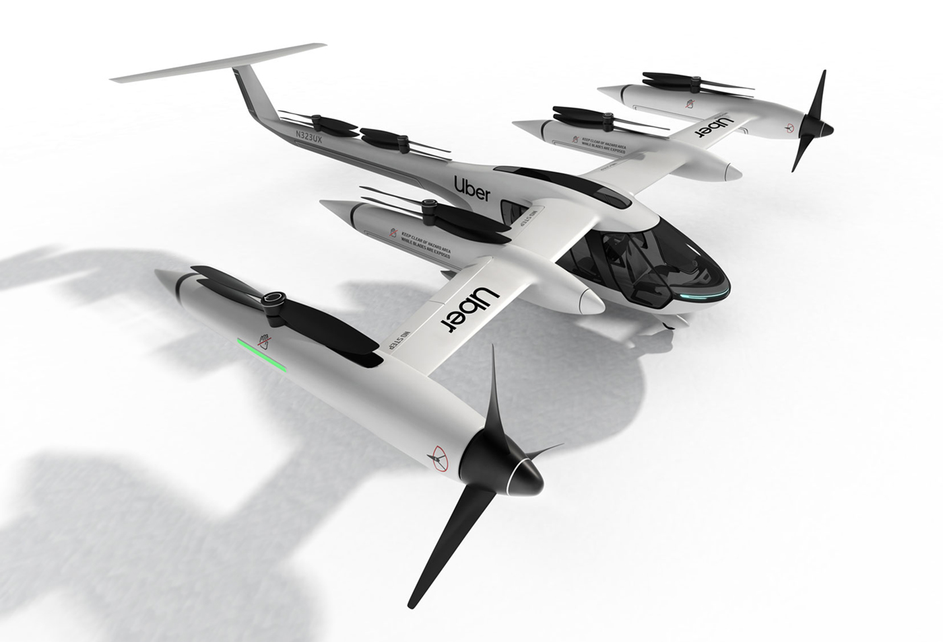
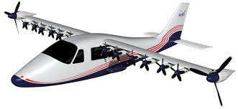
Background
Aeroacoustics
Why important?
Emergence of Urban Air Mobility
Main source of thrust is propellers - - > Propellers are noisy..!
More air vehicles in urban environments - - > More noise..!
Passenger and pedestrian discomfort - - > Critical challenge to the industry
Hybrid-Electric propulsion
Lower emissions
Lower fuel usage
Lower noise..!
To reduce noise - - > Understand the physics..!
Flight tests
Wind tunnel tests
Computational tools
Bell Nexus³
Uber Elevate²
NASA X-57 All-electric aircraft⁵
EcoPulse – Hybrid propulsion aircraft⁴
NASA’s vision on UAM¹
Notes:
Uber – begin commercial operations in 2023 in LA, Texas and Melbourne

Slide 4
ACUM
Aeroacoustic Code of the University of Maryland (ACUM)
Two versions available
One with compact chord approximation
One with distributed loads
Both rely on the periodicity of inputs
Computes acoustic pressure time history for 1 rotor/propeller revolution
Cannot handle large amounts of data
Cannot simulate non-periodic events

Slide 5
Project Goals
Develop a new version of ACUM that can simulate
Large amounts of timesteps
Non-periodic events
Flyovers
Take off and landing
Change in rotor/propeller RPM
Change in propeller angle of attack
Simulate urban environments
Modify CFD solver
Efficient processing of data needed for ACUM
Simulate non-periodic events
Non-periodic motion module
Run non-periodic cases

Slide 6
ACUM-3
Runs on GPUs
Using CUDA & C++
3-D parallelization
Observers
Elements
Timesteps
Using binning approach
Operatable on HPC clusters using MPI
To avoid memory limitations
Increased processing speed
Ability to process large amounts of non-periodic data

Slide 7
Algorithm
Read inputs
Geometric data
Surface pressure
Observer locations
Preprocess inputs
Gaussian and median filters for CFD data
Acoustic pressure computation (parallelized)
Binning approach
Write output to files
Post process to calculate OASPL at each observer
$$OASPL={20 log}_{10}\left[\frac{P−P_{mean}}{P_{ref}}\right]dB$$
$$P_{ref}=2x{10}^{−5}Pa$$

Slide 8
Binning Approach for Time Mapping
Source Time Loop
T
$$t=τ+\frac{r}{c}ω$$
$$τ_{2}$$
$$τ_{3}$$
$$τ_{360}$$
$$t_{2}$$
$$t_{3}$$
$$t_{4}$$
$$t_{360}$$
$$τ_{1}$$
$$t_{1}$$
$$t_{2}$$
$$dt$$
$$dt$$
Binning
Interpolation
$$t_{1}$$
$$dt$$
$$t_{2}$$
$$dt$$
$$t_{3}$$
$$t_{360}$$
$$t_{50}$$
$$dt$$
$$t_{51}$$
$$dt$$
$$t_{52}$$
$$t_{360}$$
$$dt$$
$$t_{1}$$
$$t_{49}$$
Observer Time Loop
T
T
$$t=t+2πn$$
Observer time loop is not required

Slide 9
GPU Parallelization
Using CUDA
Used all three dimensions for
Source elements
Observers
Time steps
Using binning approach
Race conditions
Multiple GPU threads trying to access the same data at the same time
Solved by Atomic Addition (Hardware based solution)

Slide 10
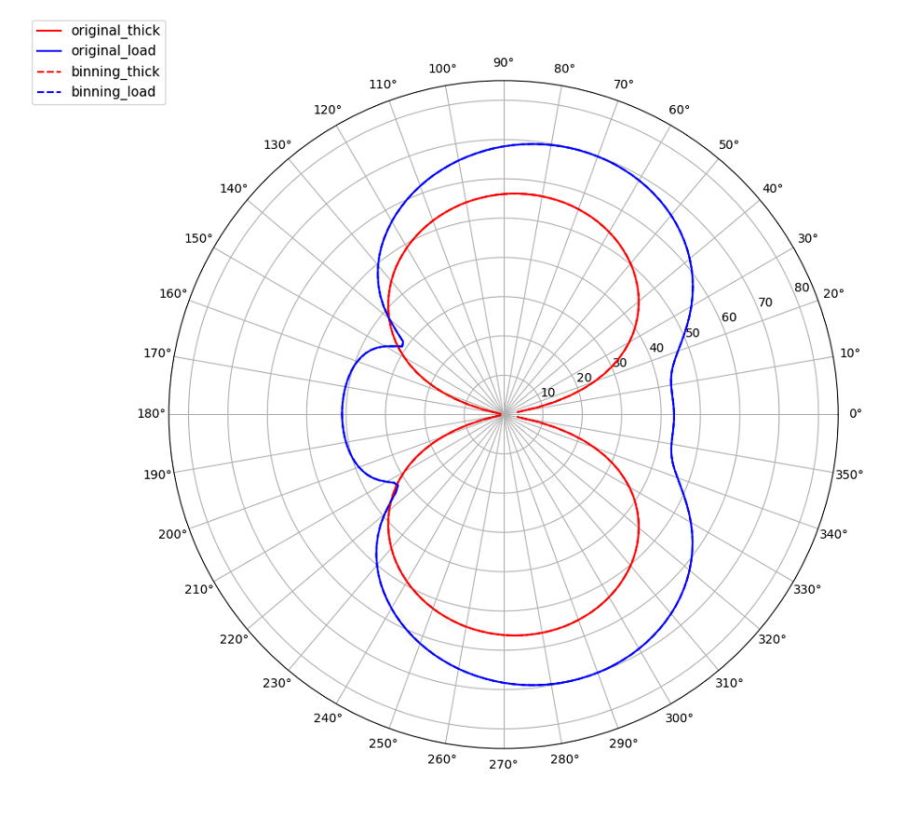
Intermediate Validation
Thickness and Loading noise in dB
For a 4-bladed propeller
Perfect match..!

Slide 11
Computational Time Optimization
Use of impermeable formulation
Ffowcs Williams-Hawkings equation has two formulations
Permeable – imaginary surface around the source
Requires flow velocity ($u, v, w$) and local density ($ρ$) at the surface
Impermeable – actual surface of the source
Does not require $u, v, w,$and $ρ$
Gaussian and median filters were used to smoothen $u, v, w, ρ, p$
Get rid of data reading and processing by choosing the impermeable formulation
Mesh coarsening
Surface mesh with tri and quad elements is subdivided to fully quads at mesh generation
CFD uses this subdivided mesh
Original mesh is good enough for ACUM (coarsening factor of 3-4)
Use of single precision over double
Atomic functions require single precision
Validated for no error
Source
$$u, v, w, ρ$$

Slide 12
Computational Time Optimization
4-bladed propeller is considered in the following comparison
360 time-steps
181 observers
Upgrade | Computational Time (s) | Reduction in Time | Total Reduction in Time
ACUM-2 | 2462.9 | - | -
ACUM-2 w/ 2D parallelization (excl. time steps) | 531.1 | 78.4% | 78.4%
ACUM-2 w/ Coarsening | 122.6 | 76.9% | 95.0%
ACUM-3 w/ 3D parallelization (binning approach) | 90.0 | 26.6% | 96.3%
ACUM-3 w/ switch to impermeable approach | 57.0 | 89.4% | 97.7%
ACUM-3 w/ switch to single precision | 48.5 | 60.4% | 98.0%

Slide 13
MPI Parallelization
CFD is set to create one output file per,
Each surface
Each chunk of time steps
Each CPU core reads and preprocesses one output file at a time
On a rolling basis (if #cores <= #chunks x #surfaces)
Different cores read and preprocess different chunks and surfaces
GPUs can be shared between many CPU cores
Some cores can read and preprocess inputs while others use GPU
Same phenomenon as in multi-threading
Each core writes the computed solutions into 2 large arrays
For thickness and loading noise
Accommodates all time steps and observers

Slide 14
Additional Data Requirement
Binning computation needs each intermediate chunk to have input data for a time step
After the last time step
Before the first time
A complete solution is not attained at the two ends of the time history due to non-periodicity
Truncate the time history based on
The longest travelling distance at the beginning
The shortest travelling distance at the end
Source
Observer
Incomplete solution
Complete solution
Observer time
Longest distance

Slide 15
Validation - Thickness Pressure
4-bladed propeller
For one revolution
At elevation angles
30 deg
45 deg
60 deg
80 deg
Truncation of time history
ACUM-2
90 deg
0 deg
ACUM-3
180 deg
270 deg

Slide 16
Thickness Time History Comparison
One Revolution
Three Revolutions

Slide 17
Flyover Simulation
Propeller is set to fly for 100 revolutions passing a set of observers at
2R, 5R, 10R, 30R, 60R, 100R, 200R, and 500R from the propeller center normal to the path
R – Propeller radius
Aerodynamic data needed for only one revolution
Input files read only at the beginning
Source location changed for each revolution inside ACUM
Pressure time history was computed for all 100 revolutions
4 CPU cores and GPUs were used in the computation
Took only 3 minutes
Instantaneous OASPL was calculated using the nearest 360 time-steps
Observers

Slide 18
Pressure Time History
Total Pressure
Loading Pressure
Thickness Pressure

Slide 19
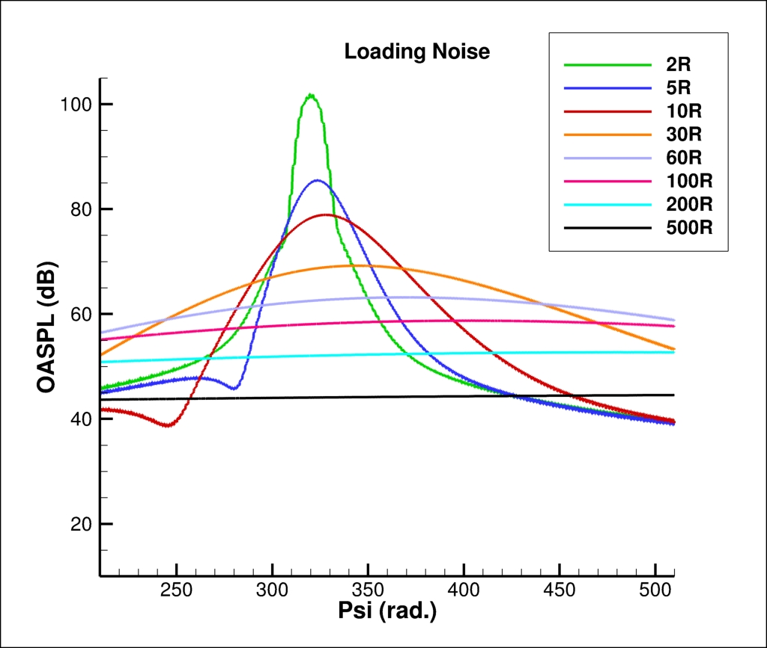
Instantaneous OASPL
Observer

Slide 20
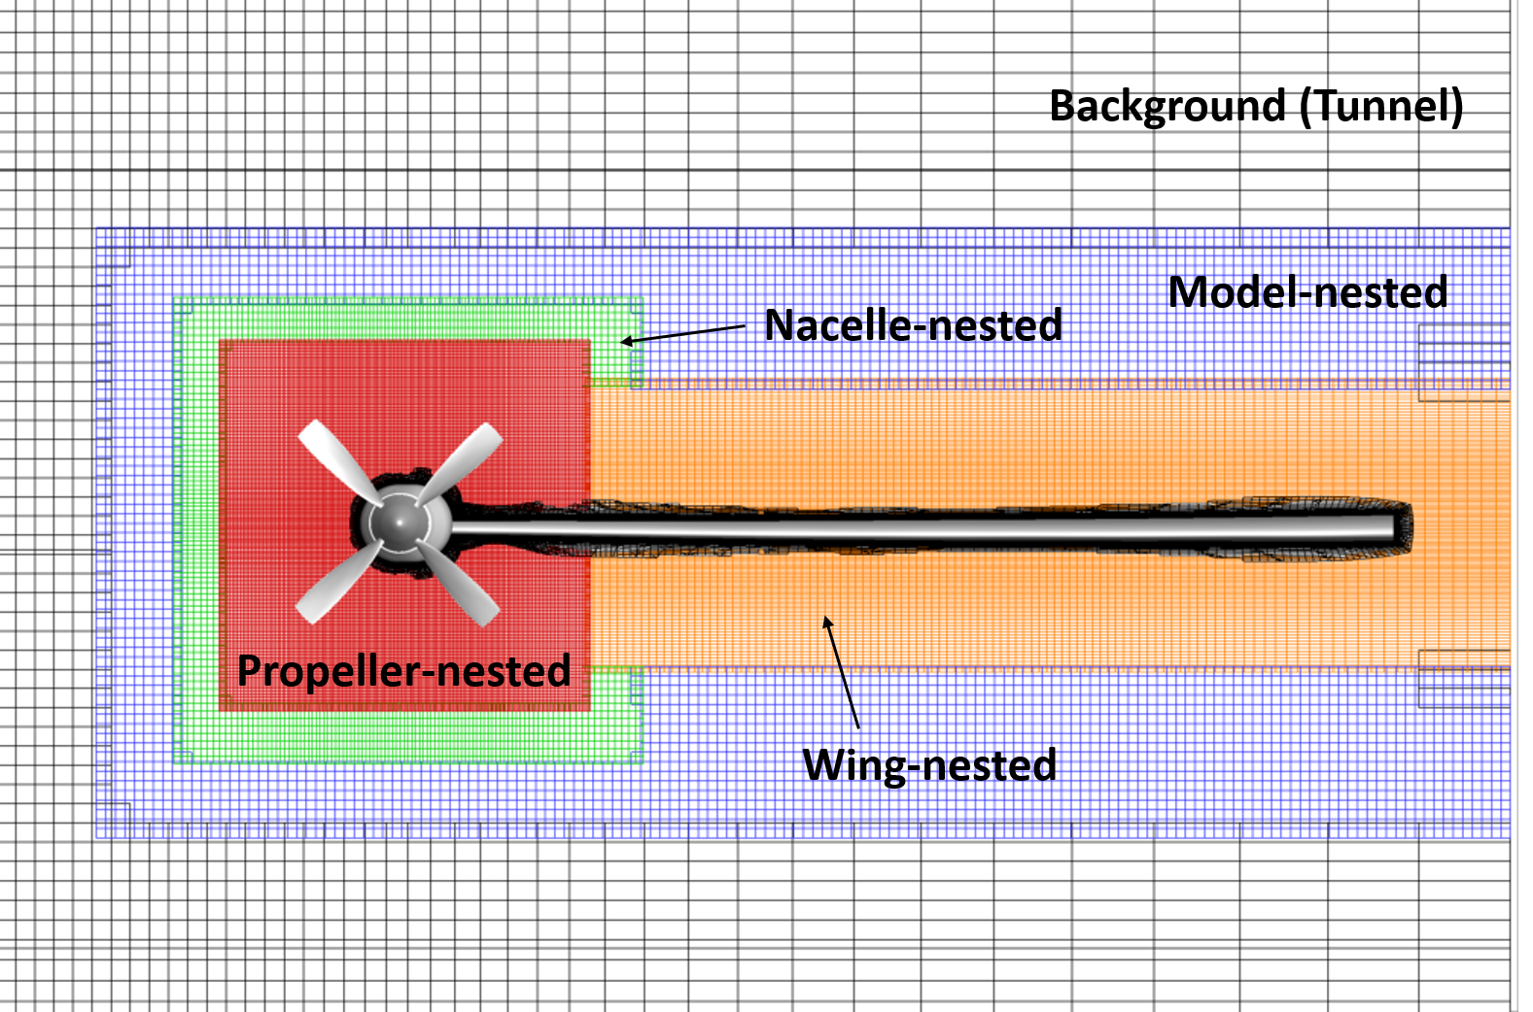
CFD Solvers
“Mercury framework” for in-house CFD
Supports an overset mesh system that can be solved by different solvers
GARFIELD solver
Accelerated using GPU
Solves structured grids
Usually used for background and nested meshes (off-body meshes)
HAMSTR solver
Solves unstructured grids
Used for near-body meshes
TIOGA
Ensures connectivity between different meshes
Transfers data between meshes by interpolation

Slide 21
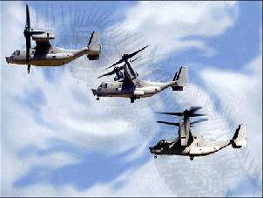
Mesh Movement
Mercury core performs mesh movements using “Motion” module
Python/C++ wrapper
Only performs periodic movements
Rotation about an axis
Elastic deflection
Uses matrix multiplications
No provisions for
Acceleration
Multi-axial rotation
Translation
Proprotor transition involves
Two rotatory motions
One about the propeller axis
One about the wing pitch axis
Accelerated translation
RPM change to balance the lift

Slide 22
Motion Matrix Multiplication
$$X_{i+1}=FR_{i+1}{\left(FR_{i}\right)}^{−1}X_{i}$$
$$X_{i}=\left\lfloor \begin{matrix}x \\ y \\ \begin{aligned}z \\ 1\end{aligned}\end{matrix}\right\rfloor −Coordinates vector at a point at i^{th}iteration$$
$F−Frame matrix$
$R−Rotation matrix= \left[\begin{matrix}cosθ & −sinθ \\ sinθ & cosθ \\ \begin{aligned}0 \\ 0\end{aligned} & \begin{aligned}0 \\ 0\end{aligned}\end{matrix} \begin{matrix}0 & 0 \\ 0 & 0 \\ \begin{aligned}1 \\ 0\end{aligned} & \begin{aligned}0 \\ 1\end{aligned}\end{matrix}\right]$
Rotation is only available around z-axis
Frame matrix is used to map the rotational axis to z-axis

Slide 23
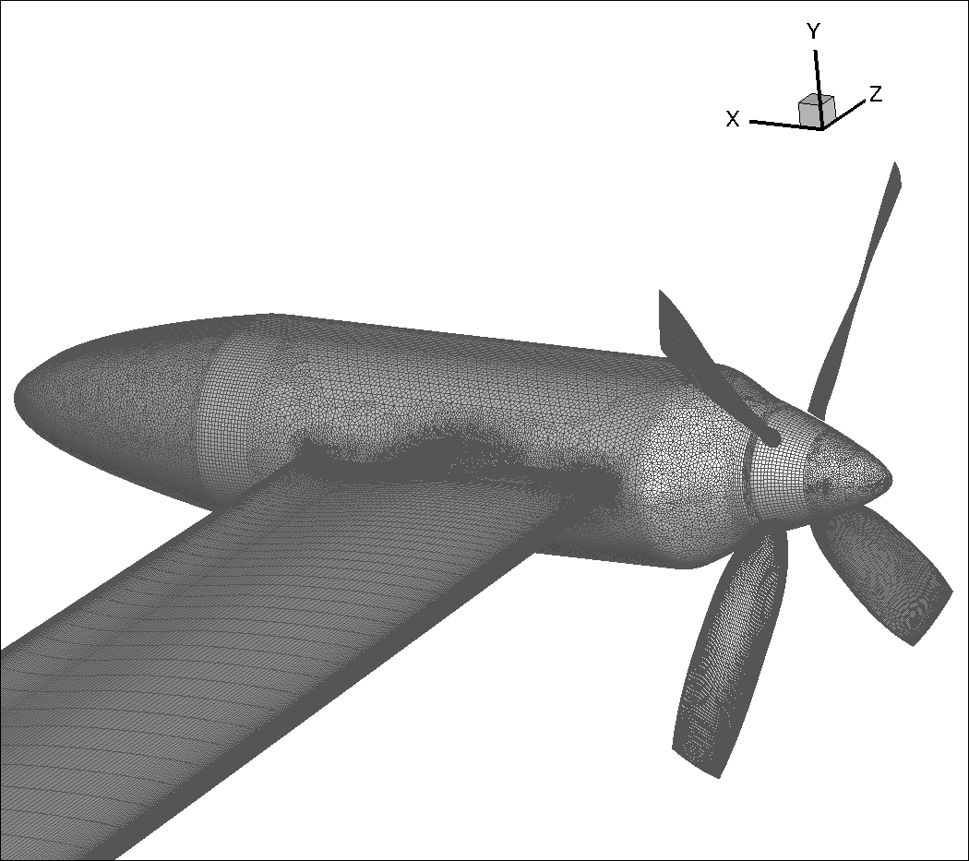
New Motion Module
Translation & primary rotation
$${X′}_{i+1}=T_{i+1}F^{[1]}R_{i+1}^{[1]}{\left(T_{i}F^{[1]}R_{i}^{[1]}\right)}^{−1}X_{i}$$
$$T−Translation matrix$$
Secondary Rotation
$$X_{i+1}={T_{i+1}F}^{[2]}R_{i+1}^{[2]}{\left(T_{i+1}F^{[2]}R_{i}^{[2]}\right)}^{−1}{X′}_{i+1}$$
$$F^{[2]}=F^{[1]}R_{i+1}^{\left[1\right]}{\left(F^{[1]}\right)}^{−1}F^{[2,0]}$$
Secondary Rotation
Primary Rotation
$$F^{[2,0]} −Original Frame Matrix for secondary rotation$$

Slide 24
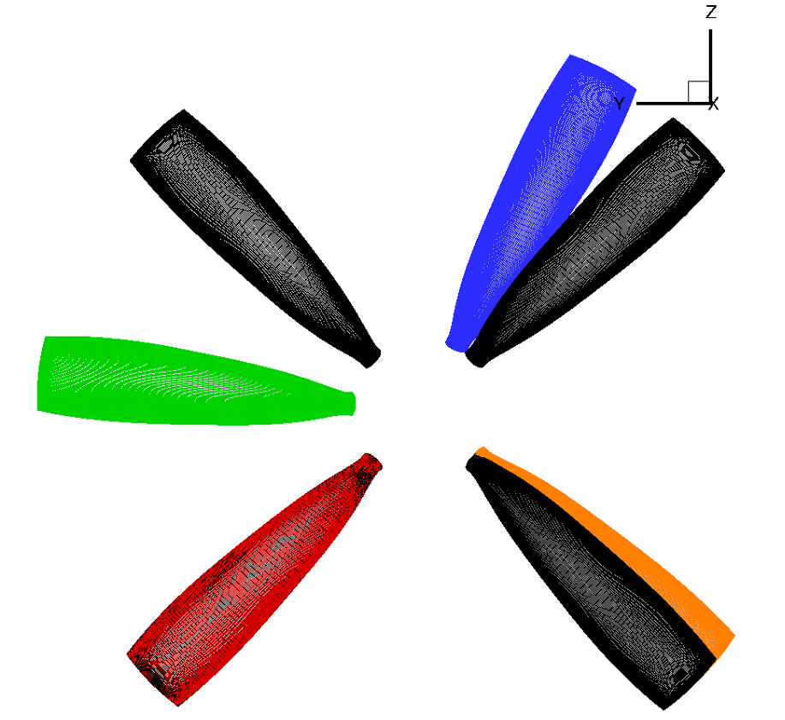
Accelerated Multi-axial Rotation with One blade
Non-accelerated blades
Accelerated blades
Z - plane
Y - plane

Slide 25
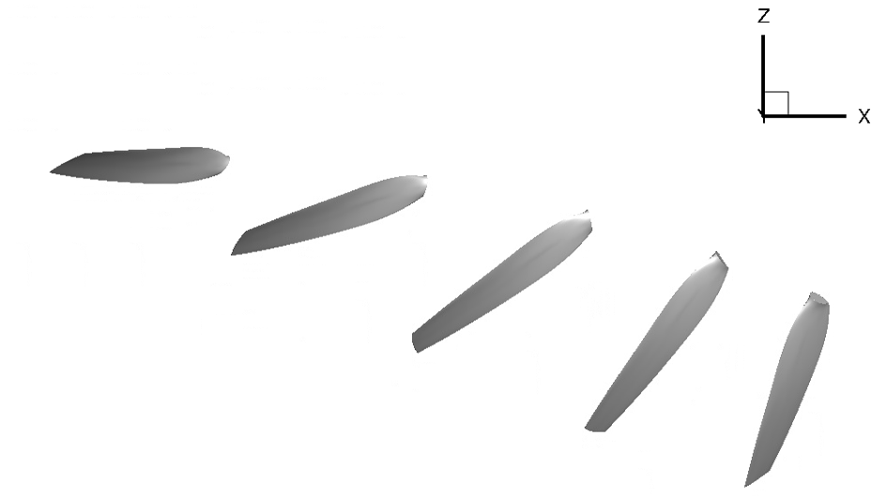
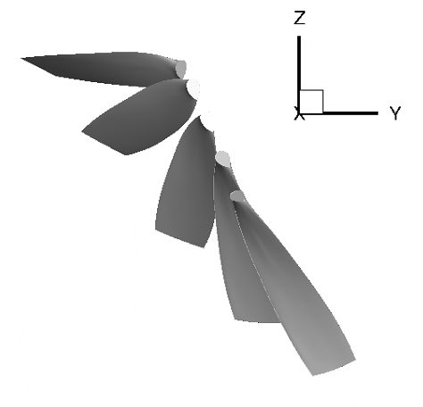
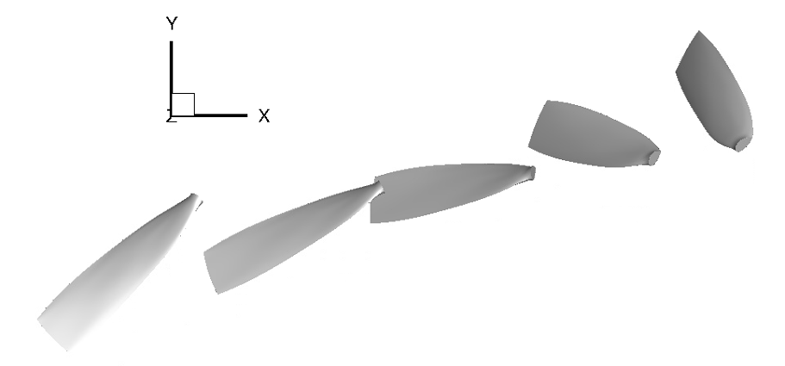
Translation + Multi-axial Rotation

Slide 26
Non-Periodic Cases
Transition from hover to cruise
Quasi-steady simulations at
0 degree
45 degree
90 degree
Unsteady simulation from 0 to 90 degrees
Takes about 5 seconds for transition
At current RPM of 98.42 Hz, this takes about 85 days to run
Reducing RPM to 30Hz helps reduce computation time
Gave negative thrust in cruise due to low RPM
Insufficient noise levels to investigate
Used 98.42 Hz with 1 second transition

Slide 27
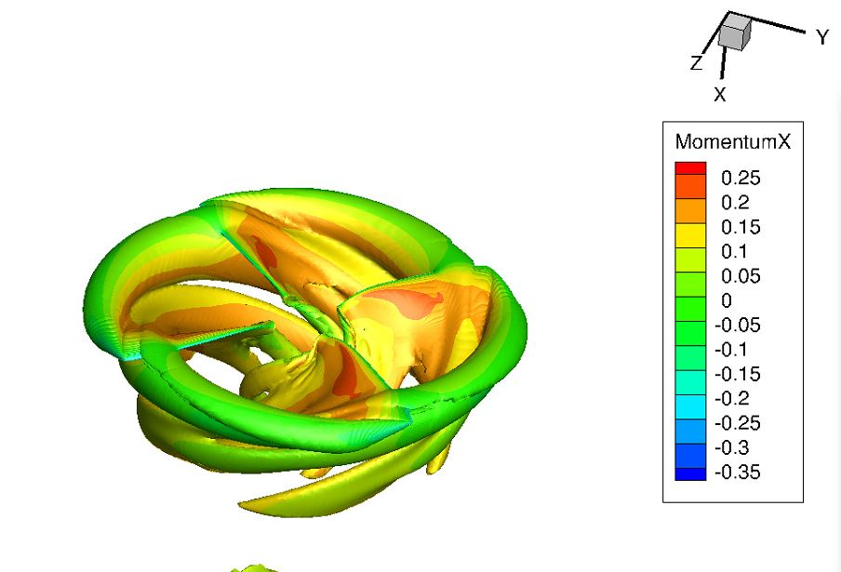
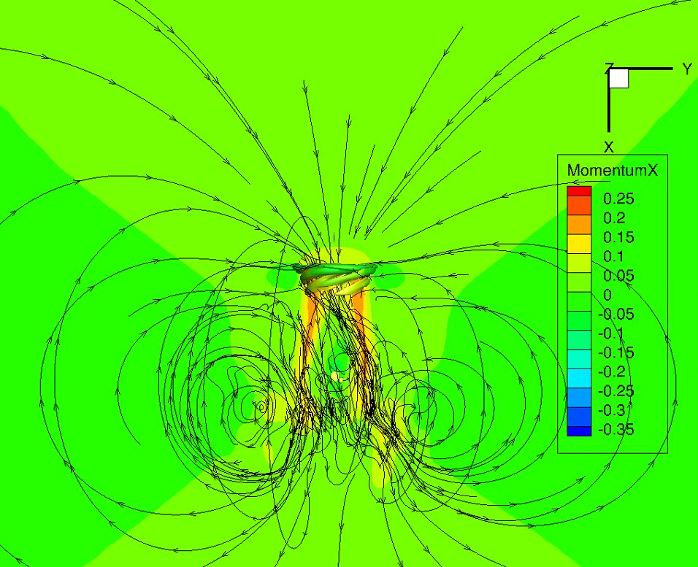
Quasi-Steady Case: Hover

Slide 28
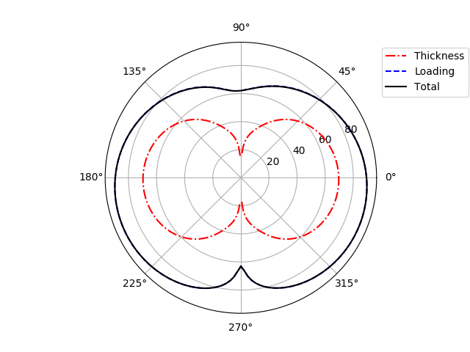
Hover Noise
RPM = 1.3*98.42 Hz
Freestream Mach number (M) = 0

Slide 29
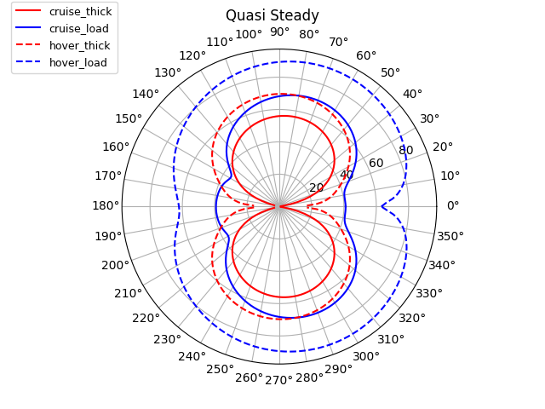
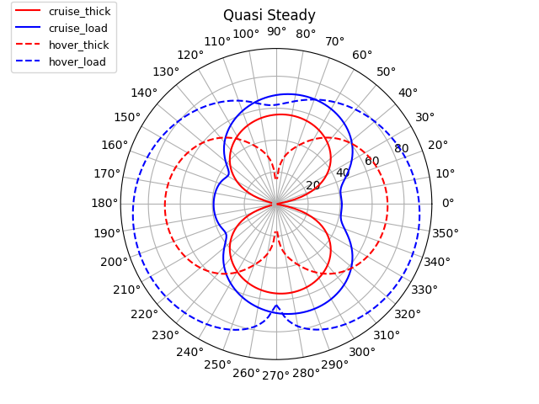
Comparison with Cruise
Hover rotated by 90 deg. to align with cruise
Both in the actual orientation

Slide 30
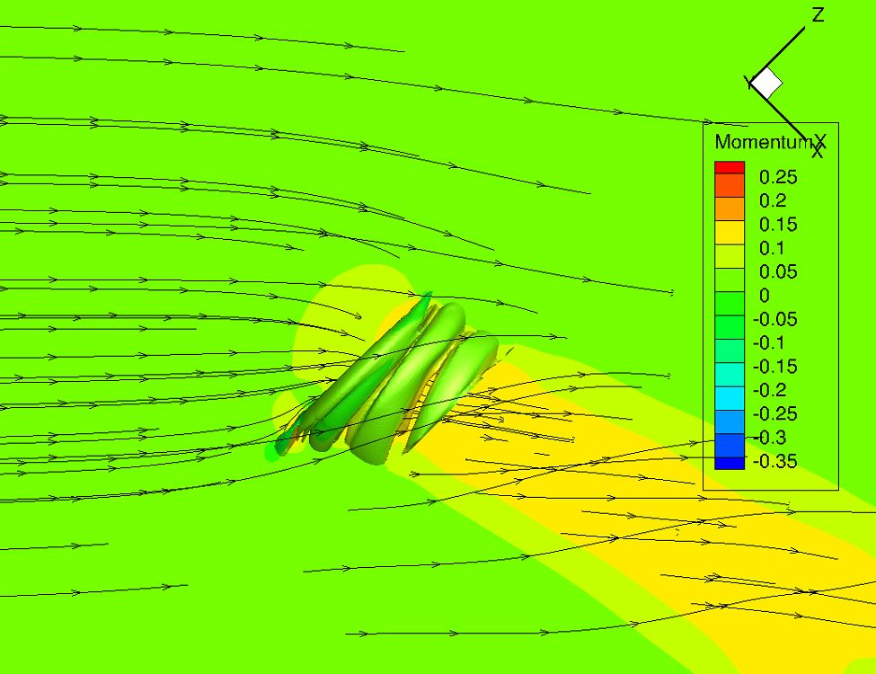
Quasi-Steady Case: 45 deg.

Slide 31
Vorticity Comparison
Cruise
45 degree
Hover

Slide 32
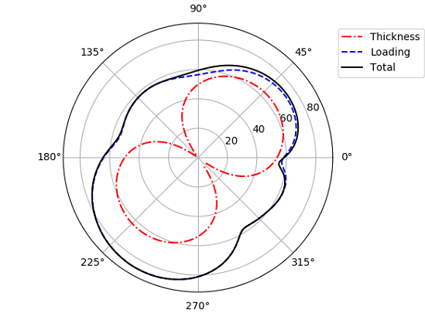
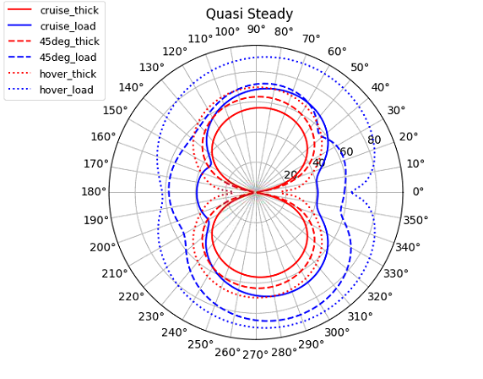
Acoustic Results
RPM = 1.15*98.42 Hz
M = 0.04
Hover and 45 deg. rotated to align with cruise

Slide 33
Quasi-Steady Total Noise

Slide 34
Coefficient of Thrust Comparison

Slide 35
Transition
Uses a 2º time step
Rotational speed reducing from 1.3*98.42Hz to 98.42Hz
Transition speed – 0.9º per revolution
Forward speed increasing from M=0 to M=0.08
Constant time step size = dt in 45 deg case
equivalent to RPM = 1.15*98.42 Hz

Slide 36
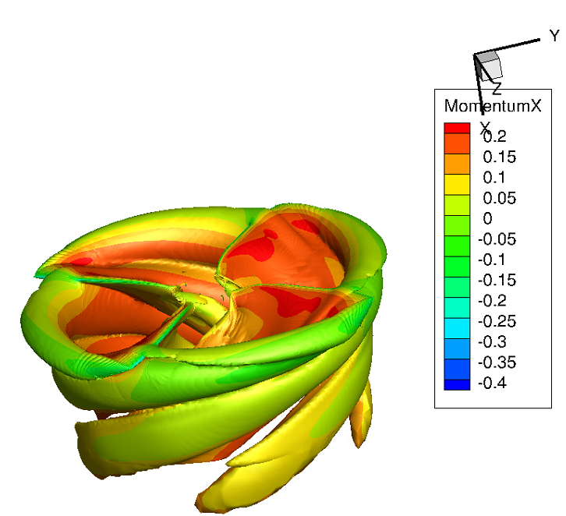
Vorticity Contour
Wake interacts with blade
Creates unsteady loading
Leads to loading noise

Slide 37
Time History
Larger oscillations for transition
ACUM is set to run with a constant rotational speed
Uses azimuth step instead of time step
Calculated time step size based on omega is higher than actual
Therefore, derivatives become larger
Omega is no longer constant
Thickness Pressure
pT / Pa
Azimuth / rad

Slide 38
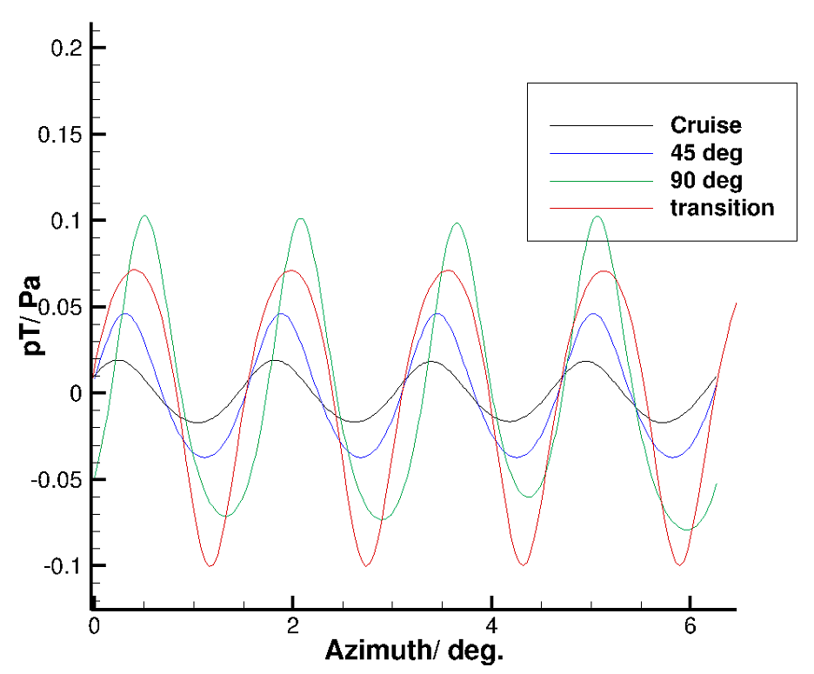
Thickness Pressure Time History
ACUM problem fixed..!
Transition curve amplitude is similar to hover
Hover
Radians

Slide 39
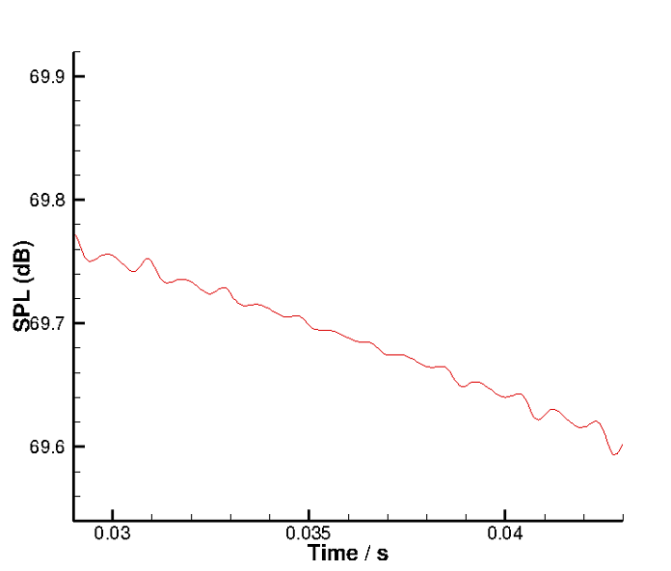
Thickness Sound Pressure Level
At the observer above the propeller
Reasonably accurate
Transition noise should start below hover
Transition
Hover

Slide 40
Thank You
Notes:
Flops = 181x360x12240x4x(425+360) = 2.5e12

